Slide 1

Index
Why Microsoft Fabric
Focus Areas for Today’s Call
Faster Data Availability – Marketing Data
ML/GenAI With Fabric
Data Fabric Architecture
Use Case Walkthrough/Demo
Initial Feedback from Users
Licensing Structure

Slide 2
Why Microsoft Fabric?
Data Fabric is an architecture that provides a unified view of data across multiple sources.
It connects data from various sources such as cloud services, databases, and file systems.
It provides an abstraction layer over the data, making it easier to access and manage.
Data Fabric allows organizations to maintain the consistency and integrity of their data.
It enables organizations to leverage their data assets to gain insights and make data-driven decisions.
Data Fabric supports various analytics use-cases such as business intelligence, machine learning, and data science.
Empowerment for Business Users
Integration with AI
Cost Efficiency
Unified Data Analytics Platform
Source :www.perplexity.ai

Slide 3
Data and Technology
Data Availability
Technology and Infrastructure
Implementation
01
03
05
02
04
Data Goverance
Skills and Capacity

Slide 4























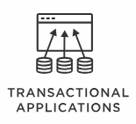

Reference architecture Data FABRIC
AUTOMATED DATA ORCHESTRATION
INTELLIGENT INTEGRATION
Transient Loading Zone
Raw Data
Data Validation
Data Cleansing
Aggregation
Source System
Refined Data
Consumption Zone
Online Transaction Processing
Original Unaltered Data attributes
Reference Data
Master Data
File Data
0101100
1100100
1000100
Discovery Sandbox
Data Wrangling
Data Discovery
Exploratory Analytics
Enterprise Data Warehouse
Tokenized Data
DB Data
Logs
Streaming Data
Active Metadata with Knowledge Graphs
Intelligent Data Quality
Data Catalog & Unified Governance
Data Security
Cloud Services
API
Data Fabric

Slide 5


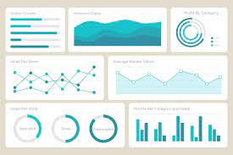
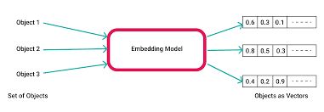

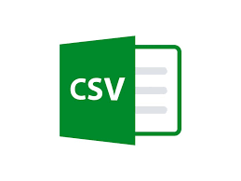





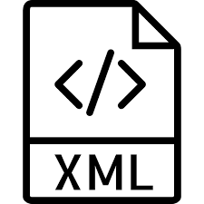












Foundation Data and Technology for Generative AI
Faster Data Onboarding
DATA SOURCES - DSI
MICROSOFT FABRIC
FEATURES/CAPABILITIES
Structured Data
BRONZE
REPORTING
Binary Parquet Files
Data type conversion
Data Factory
Power BI
Direct Lake
Dashboards & Insights
Data Model
Embeddings
Binary to Table Conversion
SILVER
Data Activator
Code Generation
Semi-Structured Data
Delta Tables
Controlled Schema
Synapse Data Engineering
ANALYTICS
AZURE MACHINE LEARNING
Business Rules Applied
Transform
GOLD
SQL Tables
Transformed with Business Rules
Synapse Data Warehousing
Shortcuts
Azure OpenAI Service
Azure AI Search
Synapse Real Time Analytics
Support for Structured and Unstructured Data
Unstructured Data
Cheaper Archival
No Data Redundancy
Enterprise Scheduler
Azure AI Language
Streaming
Documents
OneSecurity
Warehouse
Lakehouse
Pipelines
LLMOps
OneLake
AZURE ML WORKSPACE

Slide 6
Scope of PoC: Faster Data onboarding and Self Service
USE CASE – MARKETING CONTENT LOAD USING FABRIC SPARK NOTEBOOKS
Time-Consuming Process: Uploading marketing files is labor-intensive and time-consuming, leading to delays in campaign execution and data dissemination.
Human Errors: Increased risk of errors, resulting in inaccurate information, potential compliance issues, and suboptimal decision-making.
Inefficiency and Scalability Concerns: As the volume of marketing files grows, scalability is a concern limiting the ability to handle larger datasets or more complex campaigns.
Faster Insights: Manual loading inhibits the availability of real-time data insights, hindering the ability to make informed, timely adjustments to marketing strategies
PROBLEM STATEMENT:
SOLUTION:
Automated process of loading Marketing files using Fabric Spark Notebooks. Notebook is part of the pipeline created using Data Factory.
Load Delimited files (Csv’s, Txt’s) into Fabric Lakehouse in Parquet format, with each file having separate folder.
Convert Parquet files into Delta tables in the same Lakehouse.
Delta tables will be consumed in SQL Endpoint as Delta Lake or can be consumed in PowerBI report as Direct Lake.
OUTCOME & BENEFITS:
Increased Efficiency: Automation reduces the time required for file loading, enabling quicker execution of marketing campaigns and improving overall workflow efficiency.
Scalability: Automated systems can easily scale to handle larger volumes of marketing files, accommodating the growing needs of the marketing department without compromising efficiency.
Faster Insights: Automated loading facilitates the availability, empowering teams with timely insights for better decision-making and campaign optimization.
Notes:
1)Adoption and Enterprise support
2)By 2030, a major blockbuster film will be released with 90% of the film generated by AI (from text to video), from 0% of such in 2022.
3) 10% of ALL data generated by 2025 will be created by Generative AI,
Google-Med-Palm 2
AWS : Support for Huggingface in SageMaker
A 2010 study showed the average cost of taking a drug from discovery to market was about $1.8 billion, of which drug discovery costs represented about a third, and the discovery process took a whopping three to six years. Generative AI has already been used to design drugs for various uses within months, offering pharma significant opportunities to reduce both the costs and timeline of drug discovery.

Slide 7



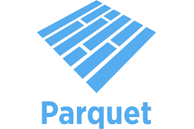









Pattern 1:Faster Data onboarding and Self Service
USE CASE – PROCESS MARKETING CONTENT INTO PARQUET FOR CONSUMPTION DOWNSTREAM
DATA SOURCE
Utility – Sweeper job to load data directly into Tables
Incremental Load
CONSUMPTION
500 rows
Inserts
Updates
200 rows
Notebooks
Spark
SQL Endpoint
Delta Lake
Marketing Content
Files
Parquet Files Partitioned
Tables
Direct Lake
LAKEHOUSE
Delta Lake Partitioned
Co-Pilot
Integration & Orchestration
Data Factory Data Pipeline
PowerBI Reports
LLM

Slide 8







Pattern 2: GenAI and ML with Microsoft Fabric
USE CASE - 2 – FETCH DATA USING PROMPTS THROUGH SEMANTIC KERNEL AND FABRIC
Documents
Tables
Data
Engineering
Lakehouse
Connect to Lakehouse
Generate data scripts (Spark, T-SQL, Python)
CSV, Spark, T-SQL
Plugins
Create
Models
Auto Integration
Semantic Kernel
T-SQL Agent
Spark Agent
CSV Agent
Azure OpenAI Services
Build OpenAI tool through Semantic Kernel and use prompt to activate data Agents
Data Science
Ask
FABRIC DATA COPILOT

Slide 9
Pattern : AI with Fabric
GenAI USE CASES
OneLake
Lakehouse
Warehouse
Shortcuts
Azure OpenAI Service
LLM
Delta – Parquet Format
Shortcut to Delta tables
Lakehouse
Shortcuts
Azure AI Search
Delta – Parquet Format
File Data
Dataset
Azure AI Language
Delta – Parquet Format
Knowledge Base

Slide 10
Initial Feedback from Users
Source : Aditya and Biswa
Advantages:
Fabric Lakehouse endpoint is accessible through SSMS environment, the backend Python script for set up has to be managed by IT as it would be more technical for the business users.
Basic SQL queries including Select, Join, Union etc. and the Window and Aggregate functions are working in the same way as expected in MS SSMS.
Users can't create any table objects, however, they can create customized views by manipulating the data for their use or to run analytics and ML models.
Users can connect the data in Fabric platform to native Power BI platform to build Business Intelligence reports.
Disadvantages:
Mapping different file formats in Fabric might involve Python script level change, and QC check functionality can be limited or needs to be handled by backend Python script.
If users would like to view/analyze several months of incremental data together in one table, it will be required to collate the files into one file/table every week, this will also require to add audit column such as file name, load date, data week etc. to identify when the data were loaded.
Further PoC/Exploration Steps:
Data load/Access performance in Fabric for the files with huge volume of data.
Create a Power BI Dashboard/Report using the data files on Fabric Data Lakehouse and document the observations and evaluate the data/dashboard refresh time.

Slide 11
Licensing Structure of Fabric
Tenant
To Consume MS Fabric contents with Power BI at least 1 from each of the below licenses are required:-
i) Organizational License
ii) Individual License
Organizational License are 3 types
Individual Licenses are 2 types:
Capacity
Workspace
License Type | Feature | Cost
Trial | Allows users to test out limited features of Microsoft Fabric | Free
Capacity | Provides Computing power for MS Fabric workloads | Pay as you consume
Premium Per User(PPU) | Allow Users to create and share all contents of Fabric and Power BI | Subscription
License Type | Feature
Free | A free license allows you to share and create content in Microsoft Fabric in case you have access to a Fabric Capacity (regardless of whether it is trial or paid), cannot create or Share Power BI Content
Pro | It gives you full accessibility to all of the functionalities and features of Fabric, including the ability to create and share content on Power BI

Slide 12
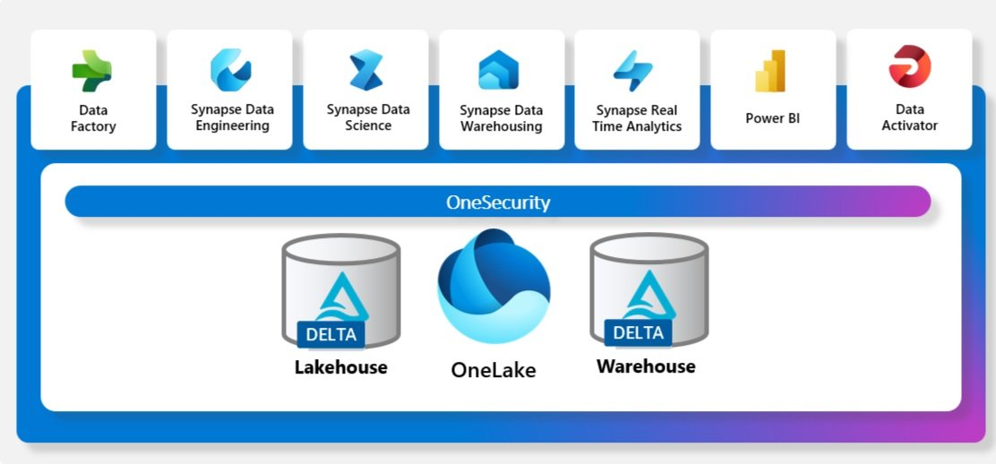
What is Microsoft Fabric
Microsoft Fabric is new way of doing things in a simplified manner
Fabric is Data Platform service offering by Microsoft
Fabric mainly comprises of Data Factory (ETL), Power BI (Visualization) and Azure Synapse (Data science and Data Engineering)
Fabric provides result driven platform for Data Analyst, Data Engineer and Data Scientist without focusing much on multiple licenses and its structures
Data Science
AI/GenAI
Data Engineering
Data Warehouse
Visualization

Slide 13
Approach with Microsoft Fabric for 2 Use Cases considered
DATA SOURCES - DSI
MICROSOFT FABRIC
FEATURES/CAPABILITIES
Structured Data
BRONZE
REPORTING
Binary Parquet Files
Data type conversion
Data Factory
Power BI
Direct Lake
Dashboards & Insights
Data Model
Embeddings
Binary to Table Conversion
SILVER
Data Activator
Code Generation
Semi-Structured Data
Delta Tables
Controlled Schema
Synapse Data Engineering
ANALYTICS
AZURE MACHINE LEARNING
Business Rules Applied
Transform
GOLD
SQL Tables
Transformed with Business Rules
Synapse Data Warehousing
Shortcuts
Azure OpenAI Service
Azure AI Search
Synapse Real Time Analytics
Unstructured Data
Enterprise Scheduler
Azure AI Language
Streaming
Documents
OneSecurity
Warehouse
Lakehouse
Pipelines
LLMOps
OneLake
AZURE ML WORKSPACE

Slide 14




Logical Separation of Workspaces
DATA SOURCES - DSI
Structured Data
Direct Access
Import mode for PBI datasets
Lakehouse Bronze
Lakehouse Silver
Lakehouse Gold
Virtualized access
Semi-Structured Data
Reporting
Unstructured Data
Warehouse Gold
Lakehouse Silver
Lakehouse Gold
Import mode for PBI datasets
Workspace - 1
Streaming
Documents
Data Validations, corrections
DATA SOURCES - DSI
Structured Data
Virtualized access
Lakehouse Bronze
Lakehouse Silver
Lakehouse Gold
Virtualized access
Lakehouse Gold
Semi-Structured Data
Lakehouse Bronze
Lakehouse Silver
Unstructured Data
Warehouse Gold
Warehouse Gold
Workspace - 2
Consumer Architecture
Streaming
Documents

Slide 15

Security and Conditional Access
DATA SOURCES - DSI
Structured Data
Direct Access
Import mode for PBI datasets
Lakehouse Bronze
Lakehouse Silver
Lakehouse Gold
Virtualized access
Semi-Structured Data
Reporting
Root
Folder 1
Folder 2
Folder 3
Unstructured Data
Warehouse Gold
Lakehouse Silver
Lakehouse Gold
Import mode for PBI datasets
Workspace - 1
Streaming
Documents
Data Validations, corrections
DATA SOURCES - DSI
Structured Data
Virtualized access
Lakehouse Bronze
Lakehouse Silver
Lakehouse Gold
Virtualized access
Lakehouse Gold
Semi-Structured Data
Lakehouse Bronze
Lakehouse Silver
Folder 1
Unstructured Data
Warehouse Gold
Folder 3
Warehouse Gold
Workspace - 2
Consumer Architecture
Streaming
Documents

Slide 16
Foundation Data and Technology for Generative AI
Faster Data Onboarding
DATA SOURCES - DSI
MICROSOFT FABRIC
FEATURES/CAPABILITIES
Structured Data
BRONZE
REPORTING
Binary Parquet Files
Data type conversion
Data Factory
Power BI
Direct Lake
Dashboards & Insights
Data Model
Embeddings
Binary to Table Conversion
SILVER
Data Activator
Code Generation
Semi-Structured Data
Delta Tables
Controlled Schema
Synapse Data Engineering
ANALYTICS
AZURE MACHINE LEARNING
Business Rules Applied
Transform
GOLD
SQL Tables
Transformed with Business Rules
Synapse Data Warehousing
Shortcuts
Azure OpenAI Service
Azure AI Search
Synapse Real Time Analytics
Unstructured Data
Enterprise Scheduler
Azure AI Language
Streaming
Documents
OneSecurity
Warehouse
Lakehouse
Pipelines
LLMOps
OneLake
AZURE ML WORKSPACE

Slide 17
Foundation Data and Technology for Generative AI
Faster Data Onboarding
DATA SOURCES - DSI
MICROSOFT FABRIC
FEATURES/CAPABILITIES
Structured Data
BRONZE
REPORTING
Binary Parquet Files
Data type conversion
Data Factory
Power BI
Direct Lake
Dashboards & Insights
Data Model
Embeddings
Binary to Table Conversion
SILVER
Data Activator
Code Generation
Semi-Structured Data
Delta Tables
Controlled Schema
Synapse Data Engineering
ANALYTICS
AZURE MACHINE LEARNING
Business Rules Applied
Transform
GOLD
SQL Tables
Transformed with Business Rules
Synapse Data Warehousing
Shortcuts
Azure OpenAI Service
Azure AI Search
Synapse Real Time Analytics
Unstructured Data
Cheaper Archival
No Data Redundancy
Enterprise Scheduler
Azure AI Language
Streaming
Documents
OneSecurity
Warehouse
Lakehouse
Pipelines
LLMOps
OneLake
AZURE ML WORKSPACE

